Slide 1



Yemeni Students Community
CTF ESSENTIALS: LEARN TO HACK
workshop
Unlock Your Potential in Ethical Hacking: Solve CTF Challenges and Become a Cybersecurity Expert
طور مهاراتك في عالم الاختراق: حل تحديات التقاط العلم وارتق بمهاراتك في الامن السيبراني

Slide 2
WHAT IS CAPTURE THE FLAG (CTF) ?
Yemeni Students Community
Definition:
Capture the Flag (CTF) is a cybersecurity competition that challenges participants to solve puzzles and uncover hidden "flags."
There are three common types of CTFs: Jeopardy-Style, Attack-Defence and mixed.
Purpose:
Simulates real-world cybersecurity scenarios.
Aims to teach practical skills through hands-on learning.
How to win:
Solve challenges to capture as many flags as possible within the competition's time limit.

Slide 3
JEOPARDY-STYLE?
Yemeni Students Community
Challenge Structure:
Each challenge includes a brief description that outlines the task and hints at the tools or skills needed to solve it.
May include resources such as files (e.g., logs, images) or URLs for analysis.
Challenge-Based Scoring System:
Challenges are assigned different point values based on their difficulty.
Solving harder challenges earns more points.
Flag format:
Flags typically follow a format such as flag{example_flag} or CTF{example123}.
submit "flags" as proof of solving the challenge, submitting the correct flag automatically updates the scoreboard.

Slide 4
CTF CHALLENGE CATEGORIES
(JEOPARDY-STYLE)
Yemeni Students Community
FORENSICS
ANALYZING DIGITAL EVIDENCE LIKE LOGS OR FILES.
MISCELLANEOUS
UNIQUE CHALLENGES MIXING VARIOUS SKILLS.
CRYPTOGRAPHY
SOLVING ENCRYPTION AND DECODING PUZZLES.
STEGANOGRAPHY
HIDING AND EXTRACTING DATA FROM IMAGES, AUDIO, ETC.
OSINT (OPEN SOURCE INTELLIGENCE)
USE OF PUBLICLY AVAILABLE INFORMATION FROM WEBSITES, SOCIAL MEDIA, AND PUBLIC RECORDS FOR INVESTIGATIVE PURPOSES.
REVERSE ENGINEERING
ANALYZING AND UNDERSTANDING COMPILED CODE.
WEB SECURITY
EXPLOITING VULNERABILITIES IN WEB APPLICATIONS.
BINARY EXPLOITATION
FINDING AND EXPLOITING VULNERABILITIES IN BINARIES.

Slide 5
IMPORTANCE OF CAPTURE THE FLAG (CTF) ?
Yemeni Students Community
Practical Learning: Provides real-world experience with cybersecurity tools and prepares participants for actual cyberattacks.
Find Weaknesses: Helps identify system vulnerabilities and enhances skills in areas like encryption and hacking.
Skill Improvement & Security Awareness: Improves defense mechanisms and raises awareness about the importance of online security.
Networking : Connects you with professionals in the field and showcases essential skills for cybersecurity jobs.
Challenge-Based Learning: Encourages learning through problem-solving in practical, competitive environments.

Slide 6
Yemeni Students Community
Q&A

Slide 7
Yemeni Students Community
DEMO

Slide 8
DEMO
Yemeni Students Community
Exif Info
CATEGORY: FORENSICS
I believe there is a password hidden and a file as well. Can you confirm it?
https://drive.google.com/drive/folders/1aOunVhylqM1p0FXAFZF94ZZINyHYgANg?usp=sharing
flag format: YSC{flag}

Slide 9
DEMO
French Secret
Yemeni Students Community
CATEGORY: CRYPTOGRAPHY
I encrypted my flag using the 'YSC' key. I bet you know which cipher I used.
WKE{Yf_0fb_$lTGfi_k34F$_eGhj4P}
flag format: YSC{flag}

Slide 10
Yemeni Students Community
Q&A

Slide 11

DEMO
Yemeni Students Community
Super salty
CATEGORY: OSINT
it's super salty... can you find out where this place is??
flag format: YSC{Name_Of_Place}

Slide 12
DEMO
Yemeni Students Community
inspect
CATEGORY: WEB SECURITY
the following code may need inspection:
https://ysc.pythonanywhere.com/inspect
flag format: YSC{flag}

Slide 13
Yemeni Students Community
Q&A

Slide 14
Yemeni Students Community
Prayer Break
until 7:30

Slide 15

Yemeni Students Community
Hands-On!
hon
ysc.pythonanywhere.com

Slide 16
Yemeni Students Community
TIME IS UP !!

Slide 17
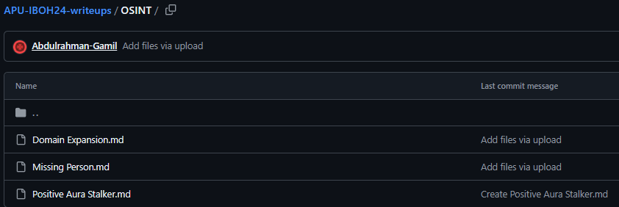
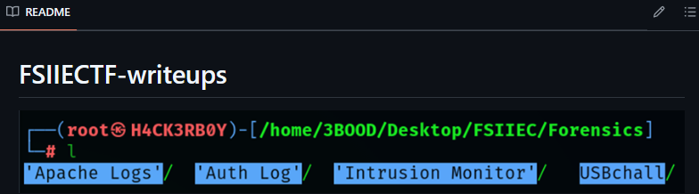
CTF WRITEUP
Yemeni Students Community
A detailed explanation of how a CTF challenge was solved, usually posted on platforms like Github, Youtube, Bloggers, or Social media.
Purpose:
Share knowledge.
Document learning.
Help others understand solutions.
Benefits:
Improves skills.
Supports community learning.

Slide 18
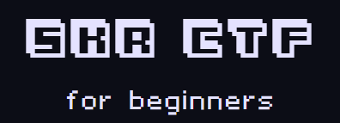
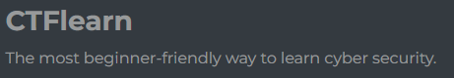






Platforms Recommended to Practice more
Yemeni Students Community

Slide 19
Yemeni Students Community
Q&A

Slide 20

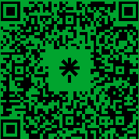
Let Us Connect :)
Yemeni Students Community
Yazen
Abdulrahman

Slide 21
Yemeni Students Community
TOP 1
AGHM

Slide 22
Yemeni Students Community
TOP 2
a18m

Slide 23
Yemeni Students Community
TOP 3
MohamedHemdan

Slide 24
Yemeni Students Community
THANK YOU
YAZEN ABOBAKR AHMED AL-MEHDHAR
&
ABDULRAHMAN GAMIL MOHAMMED AHMED

